Slide 1
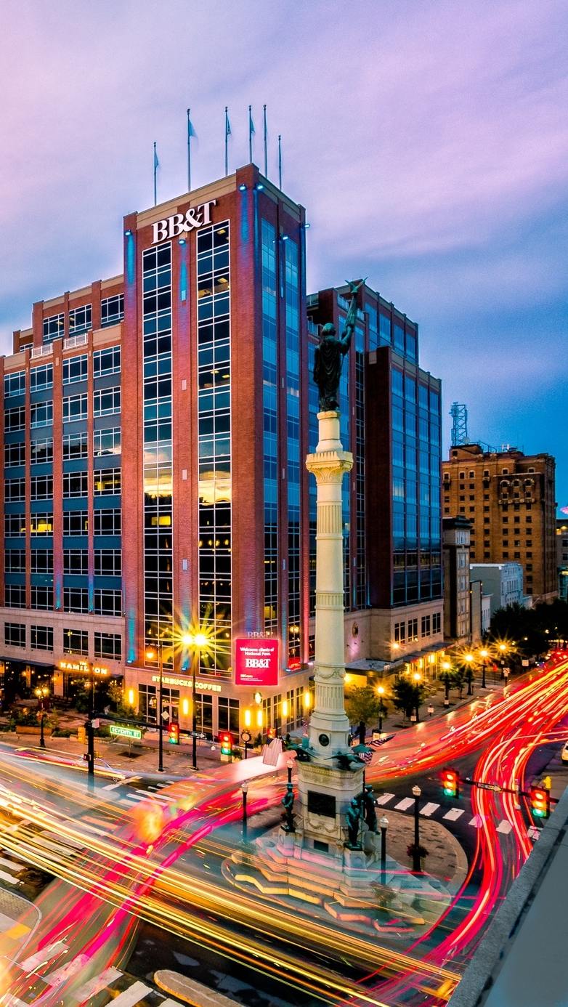

OPPORTUNITY REVIEW
DTE FINANCIAL MODELING
Exploring a SLUHN DTE Health Plan

Slide 2

SLUHN DTE PROFITABILITY MODELING STEPS
Identify service area and potential opportunity (slides 3-4).
Identify current SLUHN market share within service area (slide 5).
Reference current steerage rate of 83% for other KBA DTE networks (slide 6).
Based on service area opportunity and very conservative assumptions for steerage to SLUHN, model 20-year growth and steerage (slide 7).
Use KBA data warehouse to estimate medical costs for SLUHN members (slide 8).
Utilize KBA’s original estimate of SLUHN commercial margin (KBA originally estimated a 37% commercial margin, and then conservatively modeled at 70% of this estimate, or 25.9%).
Model plan break even points (slide 9).
Model year-four costs and revenues (slide 10).
Model costs and revenues for the first four years (slide 11).
Model 20-year annual revenue and margin returns (slide 12).
Utilize SLUHN’s reported 42% commercial margin estimate:
Model plan break even points (slide 14).
Model year-four costs and revenues (slide 15).
Model costs and revenues for the first four years (slide 16).
Model 20-year annual revenue and margin returns (slide 17).
For simplicity, these models are all based on 2024 dollars. If requested, KBA can adjust the model to account for inflationary changes.
2

Slide 3
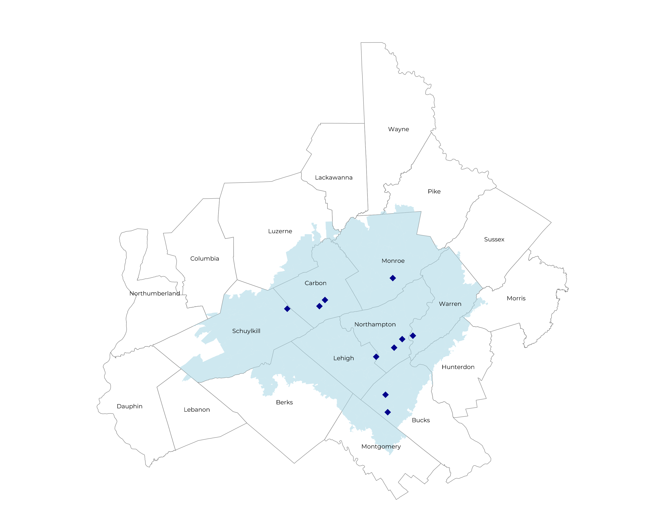
SIGNIFICANT OPPORTUNITY FOR PLAN GROWTH RESEARCHED FOR SLUHN SERVICE AREA
Target Market 1,500+ Employers 300,000+ Employees 600,000+ Members
 | Employer Size Group (# of Employees)
Commercial Employers With Headquarters | 50-100 | 101-200 | 201-400 | 401-1,000 | 1,001-3,000 | 3,000+
In Catchment Area | 956 | 385 | 236 | 119 | 31 | 21
Total Employees at Employers | 50-100 | 101-200 | 201-400 | 401-1,000 | 1,001-3,000 | 3,000+
Headquartered in Catchment Area | 71,700 | 57,800 | 70,800 | 83,300 | 62,000 | 126,000
Total Members with Employers | 50-100 | 101-200 | 201-400 | 401-1,000 | 1,001-3,000 | 3,000+
Headquartered in Catchment Area | 129,100 | 104,000 | 127,400 | 149,900 | 111,600 | 226,800
3

Slide 4
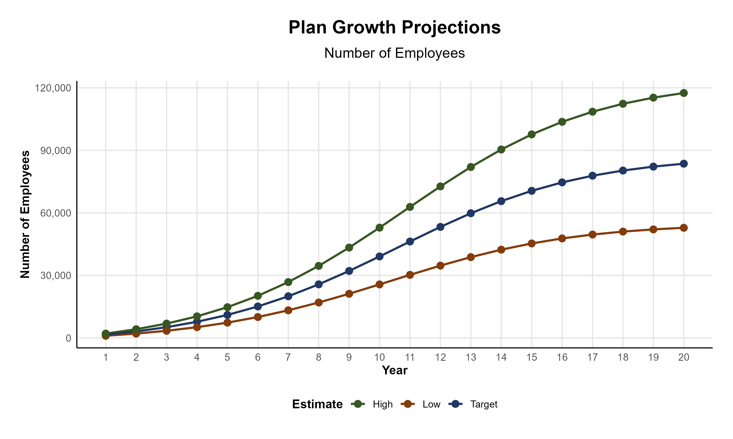
PLAN POTENTIAL GROWTH PATHS
Self Funded
382K
Insured
660K
Working Age
886K
Population
1,512K
Estimates includes the SLUHN Service Area (See Previous Slide)
4

Slide 5
CURRENT MARKET SHARE HOSPITALS WITHIN EIGHT MILES OF SLUHN SERVICE AREA
Hospital Name | Number of Beds | Inpatient Total Charges | Outpatient Total Charges | Inpatient Percent of Market Total | Outpatient Percent of Market Total (Assuming 56.1% of Physicians Employed by Hospitals)
St Luke's Warren Hospital | 92 | $ 464,369.1K | $1,008,837.0K | 2% | 2%
St. Luke's Upper Bucks Campus | 86 | $ 522,787.0K | $ 748,428.8K | 2% | 1%
St Luke's Hospital Bethlehem | 783 | $4,431,459.5K | $4,512,769.9K | 20% | 8%
Grand View Hospital | 180 | $ 313,554.5K | $ 459,480.3K | 1% | 1%
St Luke's Hospital - Easton Campus | 29 | $ 113,367.3K | $ 317,923.5K | 1% | 1%
St Luke's Miners Memorial Hospital | 49 | $ 149,719.5K | $ 428,768.3K | 1% | 1%
St Lukes Lehighton Campus | 68 | $ 193,471.3K | $ 288,155.6K | 1% | 1%
St Luke's Hospital - Anderson Campus | 193 | $1,295,917.8K | $1,620,203.3K | 6% | 3%
St Lukes Monroe Campus | 98 | $ 691,835.9K | $1,089,592.4K | 3% | 2%
St Lukes Carbon Campus | 52 | $ 307,695.2K | $ 371,559.4K | 1% | 1%
Hackettstown Medical Center | 95 | $ 419,072.8K | $ 451,745.3K | 2% | 1%
Jefferson Lansdale Hospital | 140 | $ 185,783.7K | $ 213,465.6K | 1% | <1%
Lehigh Valley Hospital - Schuylkill S Jackson Street | 118 | $ 244,006.4K | $ 346,134.4K | 1% | 1%
Lehigh Valley Hospital - Schuylkill E Norwegian Street | 99 | $ 117,895.3K | $ 181,742.1K | 1% | <1%
Penn State Health St Joseph Medical Center | 132 | $ 455,796.5K | $ 906,743.0K | 2% | 2%
Suburban Community Hospital | 111 | $ 142,533.5K | $ 95,946.3K | 1% | <1%
Pottstown Hospital | 185 | $ 464,846.7K | $ 474,286.2K | 2% | 1%
Lehigh Valley Hospital - Cedar Crest | 1,190 | $6,447,851.8K | $8,433,644.8K | 29% | 15%
Wilkes-Barre General Hospital | 188 | $ 764,343.4K | $1,091,258.7K | 3% | 2%
Lehigh Valley Hospital - Hazleton | 134 | $ 263,046.6K | $ 605,706.7K | 1% | 1%
Lehigh Valley Hospital - Pocono | 237 | $ 514,875.8K | $1,017,924.8K | 2% | 2%
Doylestown Hospital | 217 | $ 593,232.7K | $ 853,288.6K | 3% | 2%
Geisinger Wyoming Valley Medical Center | 583 | $2,190,243.6K | $4,045,390.9K | 10% | 7%
Valley Forge Medical Center and Hospital | 70 | $ 100,485.9K | $ NAK | <1% | NA%
Physicians Care Surgical Hospital | 12 | $ 46,282.1K | $ 109,933.0K | <1% | <1%
Jefferson Einstein Montgomery Hospital | 175 | $ 597,036.2K | $ 596,088.8K | 3% | 1%
Geisinger St Lukes Hospital | 60 | $ 184,744.4K | $ 275,367.2K | 1% | 1%
39% Inpatient Market Share
24% Outpatient Market Share
For outpatient market share, it is estimated that only 56.1% of local physicians are employed by area hospitals (Research from the Physician Advocacy Institute: https://www.physiciansadvocacyinstitute.org/Portals/0/assets/docs/PAI-Research/PAI-Avalere%20Physician%20Employment%20Trends%20Study%202019-2023%20Final.pdf?ver=uGHF46u1GSeZgYXMKFyYvw%3d%3d)
5

Slide 6

STEERAGE RATES FOR CURRENT DTE NETWORKS
* Data collected from KBA DTE Networks in Q1 2024
The average Tier 1 Steerage is 83%.
6

Slide 7
PROJECTED PLAN GROWTH
Year | Employees | Members | Percent of Members Choosing SLUHN for Inpatient Care | Percent of Members Choosing SLUHN for Outpatient Care
1 | 1,600 | 2,900 | 65% | 55%
2 | 3,100 | 5,600 | 65% | 55%
3 | 5,200 | 9,400 | 70% | 60%
4 | 7,800 | 14,000 | 71% | 63%
5 | 11,000 | 19,800 | 71% | 64%
6 | 15,100 | 27,200 | 72% | 64%
7 | 20,000 | 36,000 | 72% | 65%
8 | 25,700 | 46,300 | 72% | 65%
9 | 32,200 | 58,000 | 72% | 66%
10 | 39,100 | 70,400 | 72% | 66%
11 | 46,300 | 83,300 | 73% | 67%
12 | 53,300 | 95,900 | 73% | 67%
13 | 59,800 | 107,600 | 73% | 68%
14 | 65,600 | 118,100 | 73% | 68%
15 | 70,600 | 127,100 | 74% | 69%
16 | 74,600 | 134,300 | 74% | 69%
17 | 77,900 | 140,200 | 74% | 69%
18 | 80,300 | 144,500 | 74% | 70%
19 | 82,200 | 148,000 | 74% | 70%
20 | 83,600 | 150,500 | 74% | 70%
KBA currently estimates that Saint Luke's University Health Network has 39% inpatient market share, and 24% outpatient market compared to hospitals/clinics within eight (8) miles of the SLUHN service area.
KBA very conservatively projects this steerage to allow for other partners to be included in the tier 1 level if SLUHN decides.
7

Slide 8
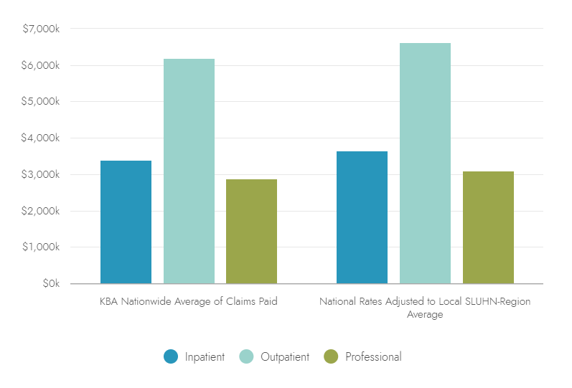


ESTIMATING LOCAL PMPY SPEND
+7%
$12,473
Average National PMPY Medical Care Costs Estimated From KBA National Trends
+7%
+7%
$13,344
Adjusted PMPY Medical Care Costs For Allentown PA
8

Slide 9

ORIGINAL ESTIMATE:
PROFITABILITY MODELED AT 26% COMMERCIAL MARGIN
9

Slide 10
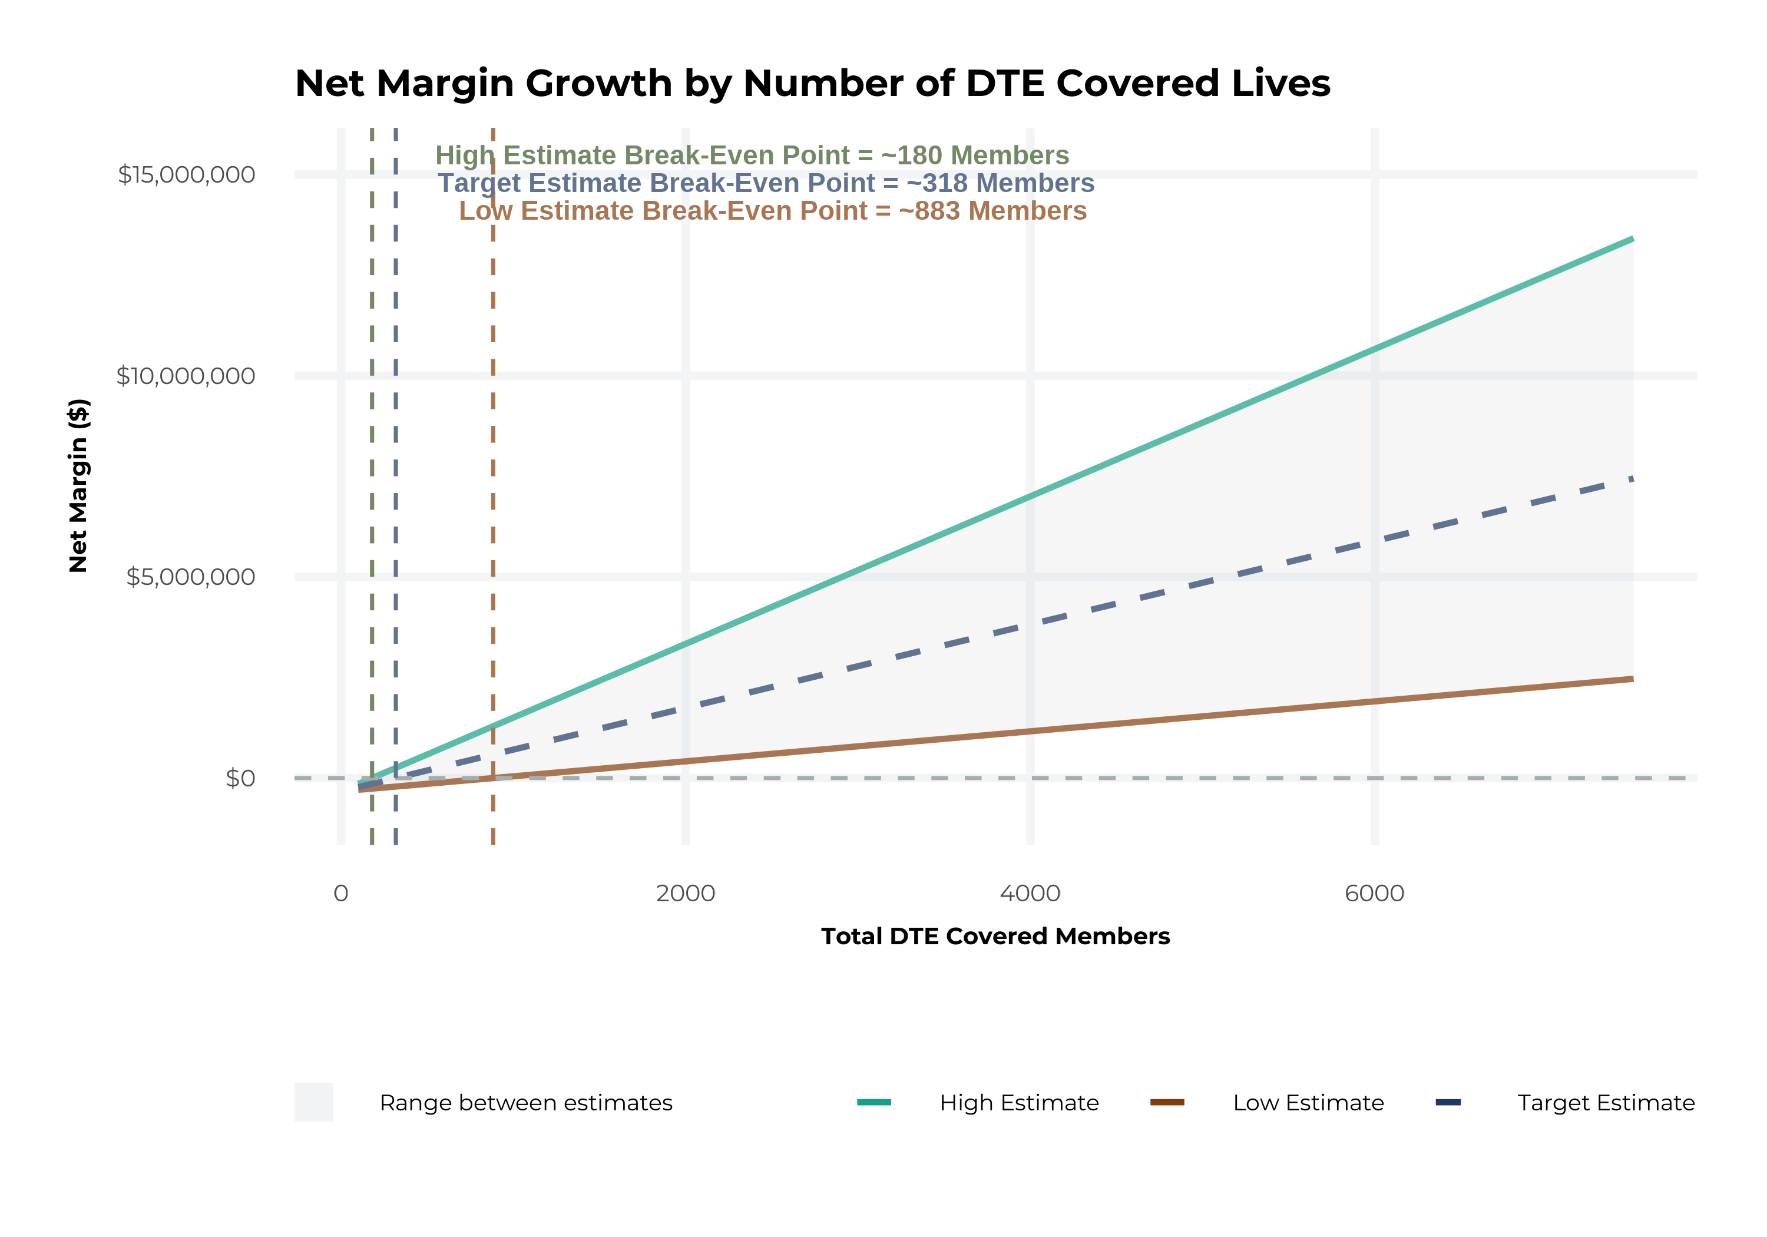
MODEL ASSUMPTIONS AND BREAK EVEN
Patient Steerage Assumptions
KBA currently estimates that Saint Luke's University Health Network has 39% inpatient market share, and 24% outpatient market compared to hospitals/clinics in the Saint Luke's University Health Network service area (see slide 8). The DTE tiered structure will create immediate steerage, with additional steerage over time from patient bonus benefits and the patient card (see slide 7 for estimates of target steerage).
Low
High
10% below target
10% above target
Commercial Margin Assumptions
KBA originally estimated that KBA has a 37% commercial margin. To ensure conservative estimates, KBA modeled at only 70% of our observed margin (70% of 37% is 25.9%).
Low
Target
High
20.9%
25.9%
30.9%

Slide 11
YEAR 4 PROJECTED REVENUE AND PROFIT
Pre-DTE Cohort of 14,000 Members | Inpatient | Outpatient | Professional | Total
Revenue† | $ 19,868,940 | $ 22,229,760 | $ 10,379,040 | $ 52,477,740
Net Income‡ | $ 5,146,055 | $ 5,757,508 | $ 2,688,171 | $ 13,591,735
† Assuming proportional revenues from market shares of 39% (inpatient) and 24% (outpatient)
‡ Conservatively assuming a commercial margin of 25.9% (70% of the estimated commercial margin)
With DTE | Inpatient | Outpatient | Professional | Total
Revenue⁰ | $ 36,089,760 | $ 58,258,669 | $ 27,200,881 | $ 121,549,310
Net Income* | $ 9,347,248 | $ 15,088,995 | $ 7,045,028 | $ 31,481,271
⁰ Assuming 71% inpatient and 63% market steerage based on KBA narrow network DTE experience (see slide 7)
* Conservatively assuming a commercial margin of 25.9% with a 10 percentage-point reduction to reflect competitive-edge rates and a 10 percentage-point increase due to lower billing costs and higher patient responsibility collections because of the member credit card.
Total Increase in Net Income | $ 17,889,537
Network Access Fee (Revenue) of $1 PMPM | $ 168,000
Total Profit Growth | $ 17,894,337
Minus Implementation Fee (One-Time) | -$ 0
Minus Sales and Marketing (Annual – Ongoing) | -$ 180,000
Total Margin Change | $ 17,877,537
11

Slide 12
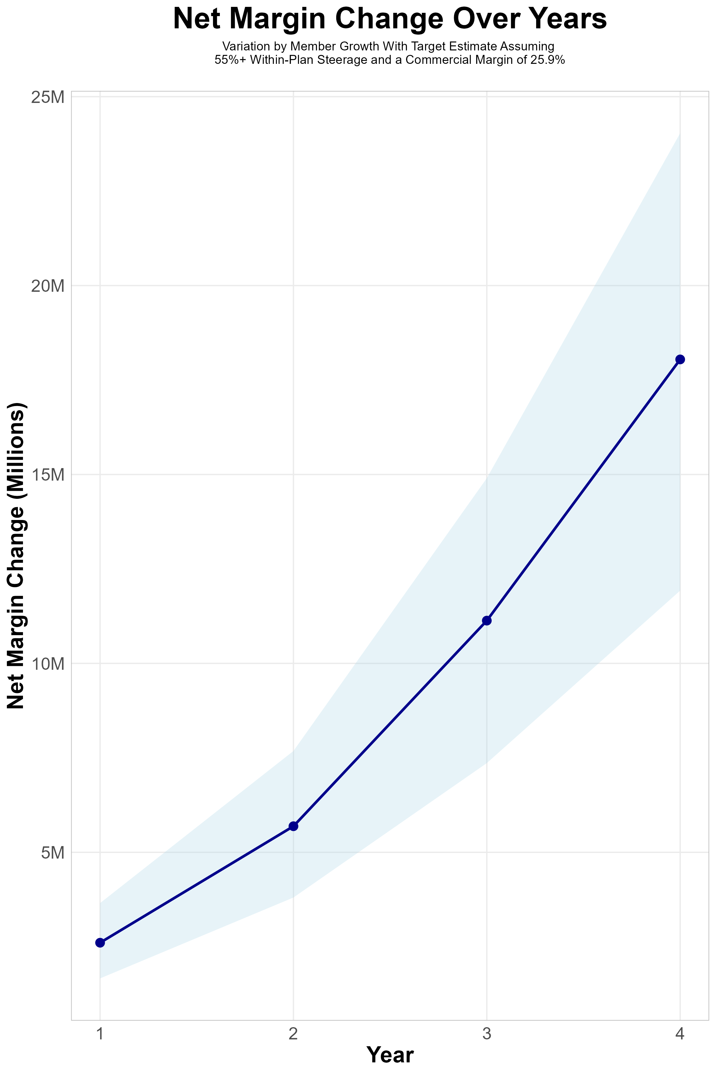
Target Member Growth | Target Member Growth | Target Member Growth | Target Member Growth | Target Member Growth
Metric | Year 1 | Year 2 | Year 3 | Year 4
Number of Members | 2,800 | 5,600 | 9,300 | 14,000
Incremental Margin | 2,903.5K | 5,803.3K | 11,200.6K | 18,057.5K
Network Access Fee | 33.6K | 67.2K | 111.6K | 168.0K
Implementation Fee (One-Time) | -150.0K | 0.0K | 0.0K | 0.0K
Sales and Marketing Costs | -180.0K | -180.0K | -180.0K | -180.0K
Net Margin Change | 2,607.1K | 5,690.5K | 11,132.2K | 18,045.5K
High Member Growth | High Member Growth | High Member Growth | High Member Growth | High Member Growth
Metric | Year 1 | Year 2 | Year 3 | Year 4
Number of Members | 3,800 | 7,500 | 12,400 | 18,600
Incremental Margin | 3,940.4K | 7,772.3K | 14,934.2K | 23,990.7K
Network Access Fee | 45.6K | 90.0K | 148.8K | 223.2K
Implementation Fee (One-Time) | -150.0K | 0.0K | 0.0K | 0.0K
Sales and Marketing Costs | -180.0K | -180.0K | -180.0K | -180.0K
Net Margin Change | 3,656.0K | 7,682.3K | 14,903.0K | 24,033.9K
Low Member Growth | Low Member Growth | Low Member Growth | Low Member Growth | Low Member Growth
Metric | Year 1 | Year 2 | Year 3 | Year 4
Number of Members | 1,900 | 3,800 | 6,200 | 9,300
Incremental Margin | 1,970.2K | 3,938.0K | 7,467.1K | 11,995.4K
Network Access Fee | 22.8K | 45.6K | 74.4K | 111.6K
Implementation Fee (One-Time) | -150.0K | 0.0K | 0.0K | 0.0K
Sales and Marketing Costs | -180.0K | -180.0K | -180.0K | -180.0K
Net Margin Change | 1,663.0K | 3,803.6K | 7,361.5K | 11,927.0K
12

Slide 13
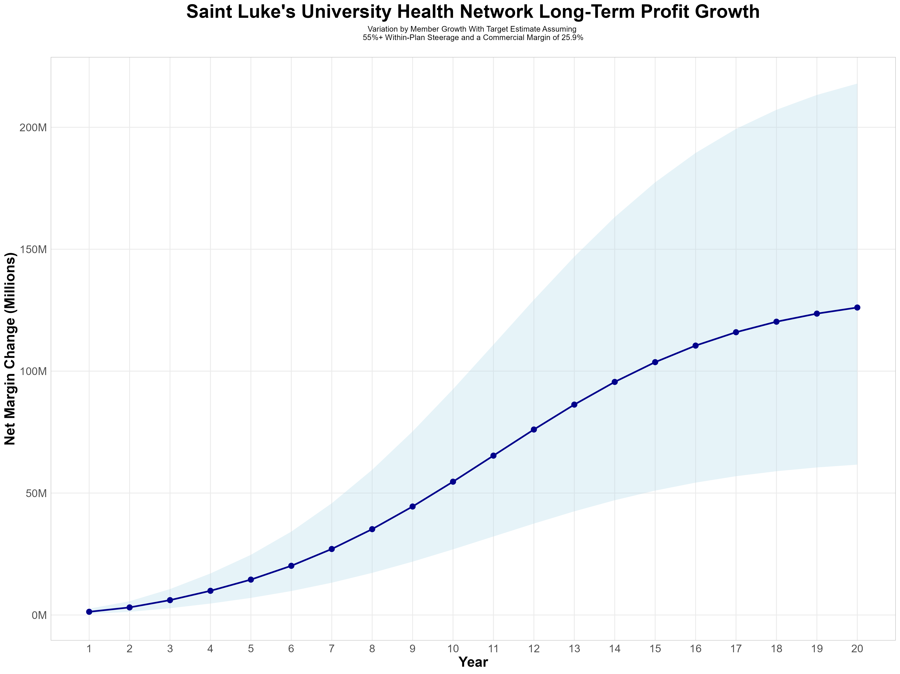
GROWING POWERFUL, LASTING PROFITABILITY
Early Stage
Gaining Name Recognition, Early Growth
New Revenue:
New Profit:
$35.58M
$9.19M
Growth Stage
Strong Reputation, Strong Growth
New Revenue:
New Profit:
$211.65M
$55.59M
Mature Stage
High Profitability, Market Saturation
New Revenue:
New Profit:
$432.48M
$113.67M
13

Slide 14
UPDATED VERSION:
PROFITABILITY MODELED AT 42% COMMERCIAL MARGIN
14

Slide 15
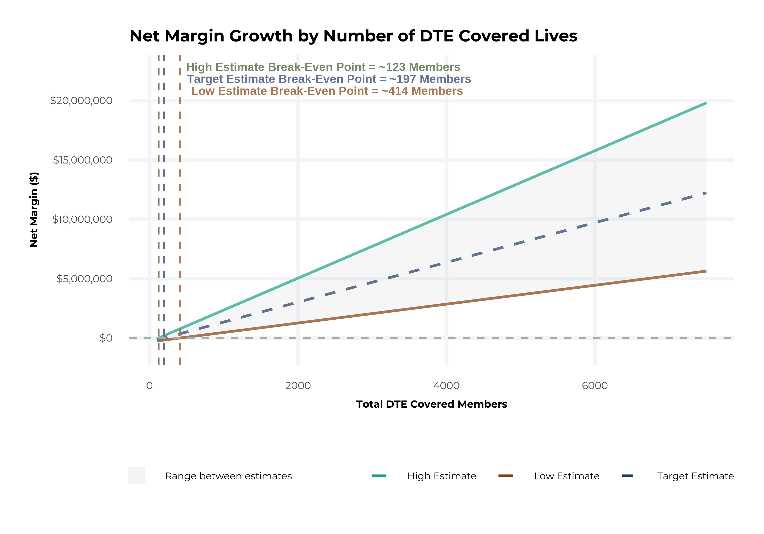
MODEL ASSUMPTIONS AND BREAK EVEN
Patient Steerage Assumptions
KBA currently estimates that Saint Luke's University Health Network has 39% inpatient market share, and 24% outpatient market compared to hospitals/clinics in the Saint Luke's University Health Network service area (see slide 8). The DTE tiered structure will create immediate steerage, with additional steerage over time from patient bonus benefits and the patient card (see slide 34 for estimates of target steerage).
Low
High
10% below target
10% above target
Commercial Margin Assumptions
KBA is utilizing the SLUHN-reported 42% commercial margin for this analysis.
Low
Target
High
37%
42%
47%

Slide 16
YEAR 4 PROJECTED REVENUE AND PROFIT
Pre-DTE Cohort of 14,000 Members | Inpatient | Outpatient | Professional | Total
Revenue† | $ 19,868,940 | $ 22,229,760 | $ 10,379,040 | $ 52,477,740
Net Income‡ | $ 8,344,955 | $ 9,336,499 | $ 4,359,197 | $ 22,040,651
† Assuming proportional revenues from market shares of 39% (inpatient) and 24% (outpatient)
‡ Estimating with SLUHN’s reported commercial margin of 42%
With DTE | Inpatient | Outpatient | Professional | Total
Revenue⁰ | $ 36,089,760 | $ 58,258,669 | $ 27,200,881 | $ 121,549,310
Net Income* | $ 15,157,699 | $ 24,468,641 | $ 11,424,370 | $ 51,050,710
⁰ Assuming 71% inpatient and 63% market steerage based on KBA narrow network DTE experience (see previous slide)
* Estimating with SLUHN’s reported commercial margin of 42%, with a 10 percentage-point reduction to reflect competitive-edge rates and a 10 percentage-point increase due to lower billing costs and higher patient responsibility collections because of the member credit card.
Total Increase in Net Income | $ 29,010,060
Network Access Fee (Revenue) of $1 PMPM | $ 168,000
Total Profit Growth | $ 29,014,860
Minus Implementation Fee (One-Time) | -$ 0
Minus Sales and Marketing (Annual – Ongoing) | -$ 180,000
Total Margin Change | $ 28,998,060
16

Slide 17
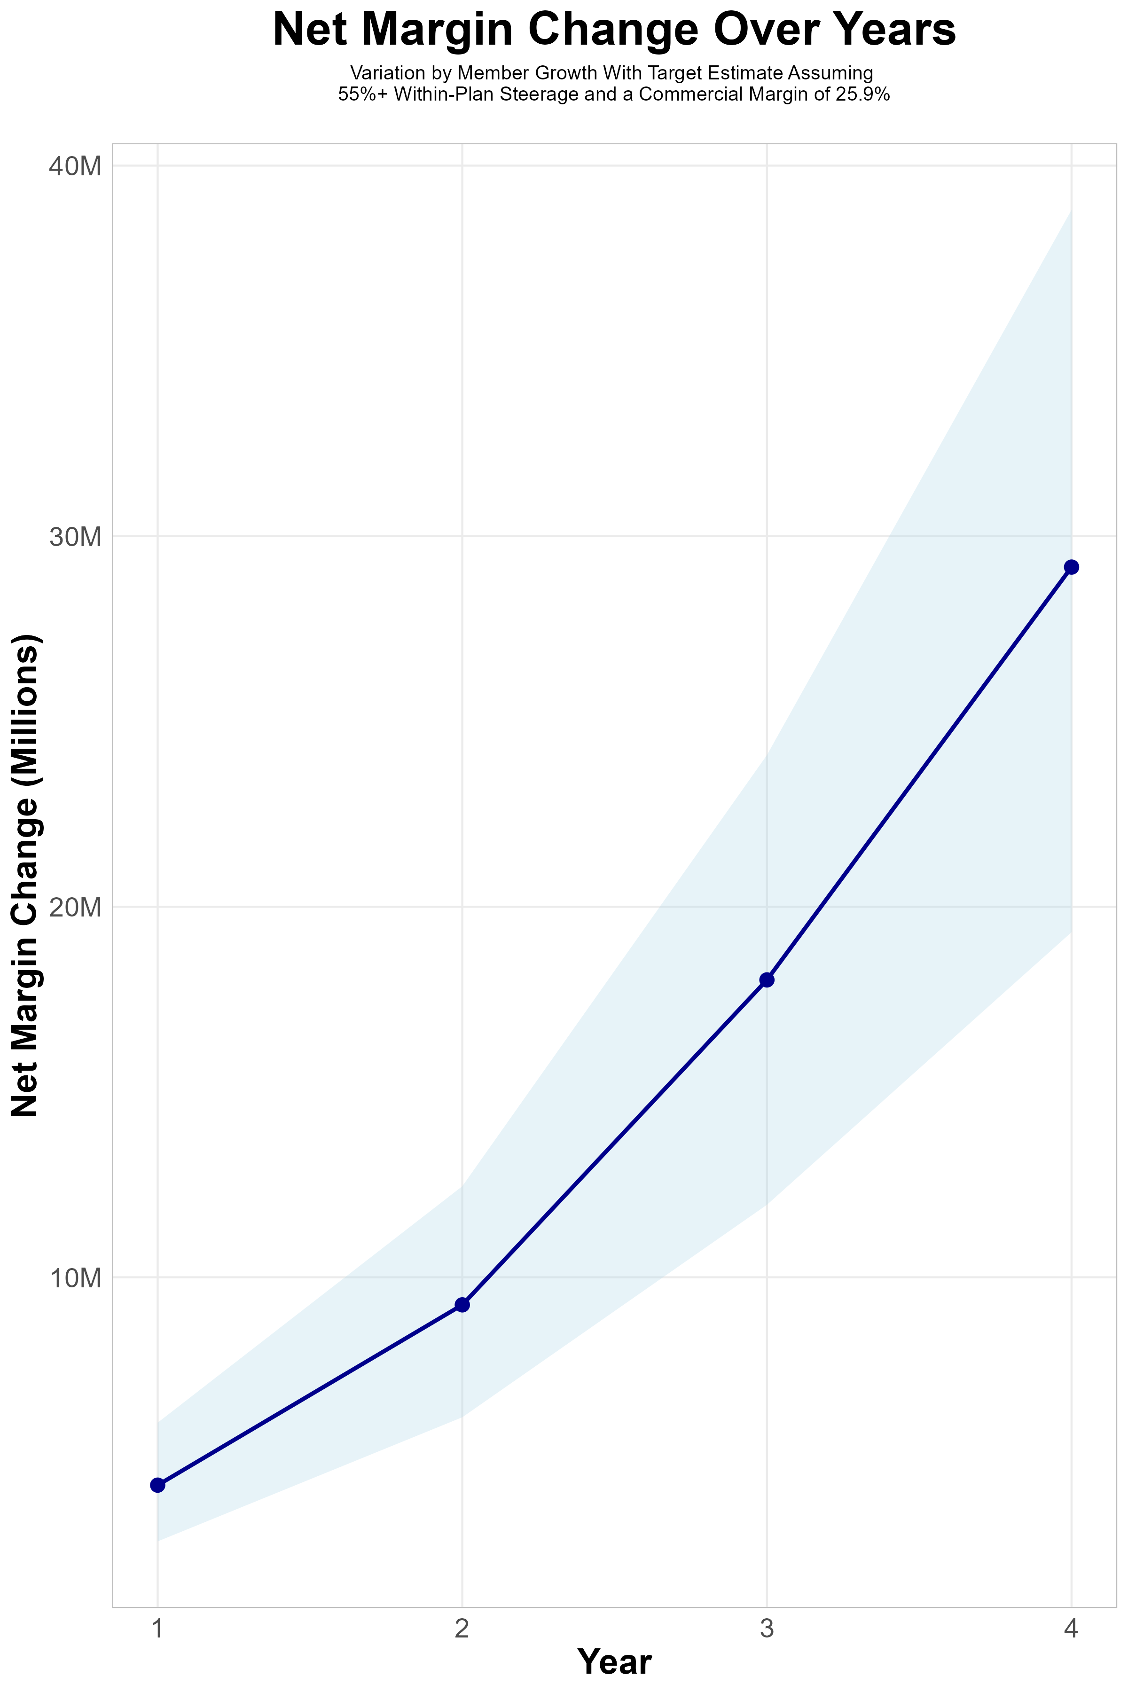
Target Member Growth | Target Member Growth | Target Member Growth | Target Member Growth | Target Member Growth
Metric | Year 1 | Year 2 | Year 3 | Year 4
Number of Members | 2,800 | 5,600 | 9,300 | 14,000
Incremental Margin | 4,687.4K | 9,369.0K | 18,093.8K | 29,178.1K
Network Access Fee | 33.6K | 67.2K | 111.6K | 168.0K
Implementation Fee (One-Time) | -150.0K | 0.0K | 0.0K | 0.0K
Sales and Marketing Costs | -180.0K | -180.0K | -180.0K | -180.0K
Net Margin Change | 4,391.0K | 9,256.2K | 18,025.4K | 29,166.1K
High Member Growth | High Member Growth | High Member Growth | High Member Growth | High Member Growth
Metric | Year 1 | Year 2 | Year 3 | Year 4
Number of Members | 3,800 | 7,500 | 12,400 | 18,600
Incremental Margin | 6,361.5K | 12,547.8K | 24,125.0K | 38,765.1K
Network Access Fee | 45.6K | 90.0K | 148.8K | 223.2K
Implementation Fee (One-Time) | -150.0K | 0.0K | 0.0K | 0.0K
Sales and Marketing Costs | -180.0K | -180.0K | -180.0K | -180.0K
Net Margin Change | 6,077.1K | 12,457.8K | 24,093.8K | 38,808.3K
Low Member Growth | Low Member Growth | Low Member Growth | Low Member Growth | Low Member Growth
Metric | Year 1 | Year 2 | Year 3 | Year 4
Number of Members | 1,900 | 3,800 | 6,200 | 9,300
Incremental Margin | 3,180.7K | 6,357.6K | 12,062.5K | 19,382.6K
Network Access Fee | 22.8K | 45.6K | 74.4K | 111.6K
Implementation Fee (One-Time) | -150.0K | 0.0K | 0.0K | 0.0K
Sales and Marketing Costs | -180.0K | -180.0K | -180.0K | -180.0K
Net Margin Change | 2,873.5K | 6,223.2K | 11,956.9K | 19,314.2K
17

Slide 18
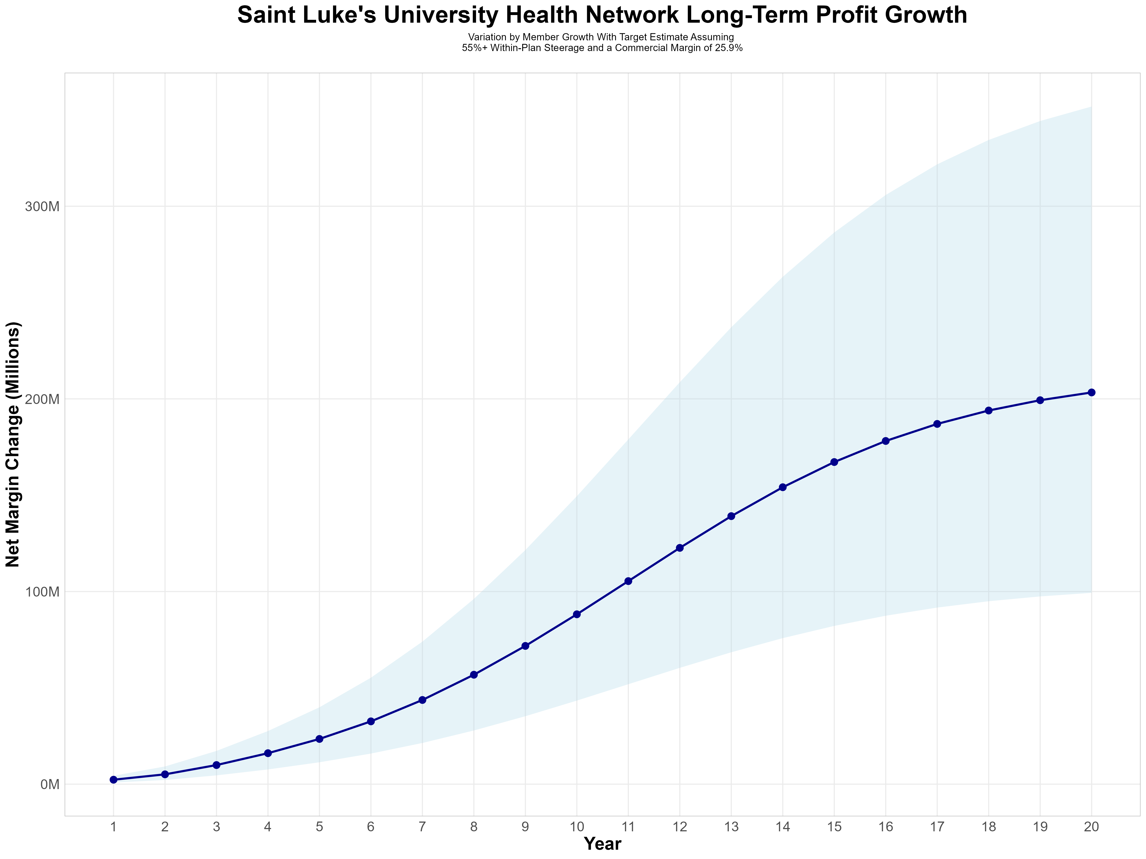
GROWING POWERFUL, LASTING PROFITABILITY
Early Stage
Gaining Name Recognition, Early Growth
New Revenue:
New Profit:
$35.58M
$14.91M
Growth Stage
Strong Reputation, Strong Growth
New Revenue:
New Profit:
$211.65M
$89.66M
Mature Stage
High Profitability, Market Saturation
New Revenue:
New Profit:
$432.48M
$183.3M
18

